Slide 1
a survival guide
for retail banking
Mid-Sized Credit Union CEO Roundtable
October 9, 2024
joe sullivan, ceo
market insights

Slide 2

Notes:
Survival – a metaphor July 2019 – Mount Si – western rim of the Cascade range
In the Hiking/Wilderness World
Nutrition
Hydration
Navigation
Protection from the elements
In the Credit Union World:
core system modernization
data quality and accessibility
generative AI
speed and agility, and
collaboration and partnerships

Slide 3

© 2024 Market Insights | 3

Slide 4



© 2024 Market Insights | 4

Slide 5
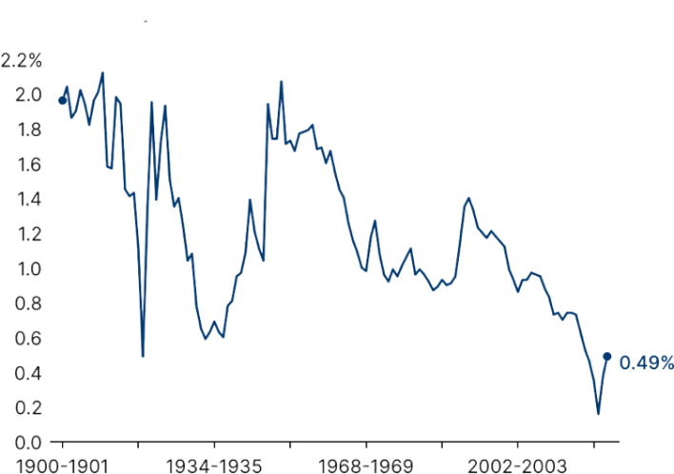

demographics
© 2024 Market Insights | 5

Slide 6





shoppers spend
$455K
users send $463K
in payments
people trade $398M
in Treasury Bonds
users submit
6,060 resumes
Source: DOMO 2023, data.ai
© 2024 Market Insights | 6

Slide 7

economic uncertainty
© 2024 Market Insights | 7

Slide 8
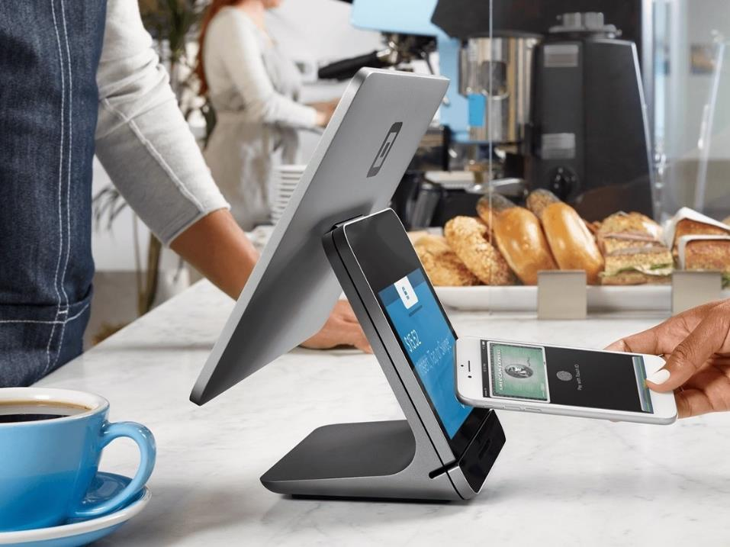
competition
© 2024 Market Insights | 8

Slide 9

regulatory pressure
© 2024 Market Insights | 9

Slide 10

pace of technology
© 2024 Market Insights | 10

Slide 11

The wave of innovation
that is coming is so intense
and so potent and so pervasive,
it will literally reshape our human existence.
Amy Webb, CEO, Future Today Institute
at SXSW 2024 (March 2024)
© 2024 Market Insights | 11

Slide 12

© 2024 Market Insights | 12

Slide 13

core system modernization
member
centricity
© 2024 Market Insights | 13

Slide 14

data quality/
accessibility
empathy
© 2024 Market Insights | 14

Slide 15

AI/GenAI
continuous learning/
upskilling
© 2024 Market Insights | 15

Slide 16

speed
agility/
adaptability
© 2024 Market Insights | 16

Slide 17

partnerships/ collaboration
building professional
networks
© 2024 Market Insights | 17

Slide 18
© 2024 Market Insights | 18

Slide 19


“If we don’t get this right, it’s OK...but we have to make progress every day.
As long as we’re making progress, we’ll get better.”
– Steve Schnall, Quontic Bank
© 2024 Market Insights | 19

Slide 20

thank you
joe sullivan, ceo
jsullivan@formarketinsights.com
@mi_sullivan
312.961.0188
linkedin.com/in/mijoesullivan

