Slide 1
Mid-Sized CU CEO Roundtable
October 10, 2024

Slide 2

Presenter:
Todd Baumann
Risk & Cybersecurity
Senior Manager
614.623.7817
tbaumann@gbq.com

Slide 3
Agenda
Threats and Risks Facing Credit Unions
Managing Cyber Risks with the Cybersecurity Framework
Ensuring Business Continuity, Disaster Recovery and Incident Response, Crisis Management
Developing Plans
Crisis Management and Recovery
Mitigating Vendor Risks
Evaluating Security Measures
Summary and Discussion

Slide 4
Threats & Risks Facing Credit Unions
Ransomware Attacks | Phishing and Social Engineering | Third-Party Vendor Risks | Legacy Systems and Outdated Technology | Shortage of Cybersecurity Talent
Encrypts critical data, causing operational disruptions and financial losses. Leads to ransom payments and loss of member trust. | Tricks employees/members into revealing sensitive information. Results in unauthorized access, financial fraud, and data theft. | Exploits vulnerabilities in vendor networks, compromising credit unions. Lack of vendor oversight creates risk management blind spots. | Outdated systems lack critical security updates, easy targets for cybercriminals. Hinders implementation of modern security measures. | Difficulty in managing digital defenses due to lack of skilled professionals. Inadequate responses to evolving threats increase vulnerability.

Slide 5
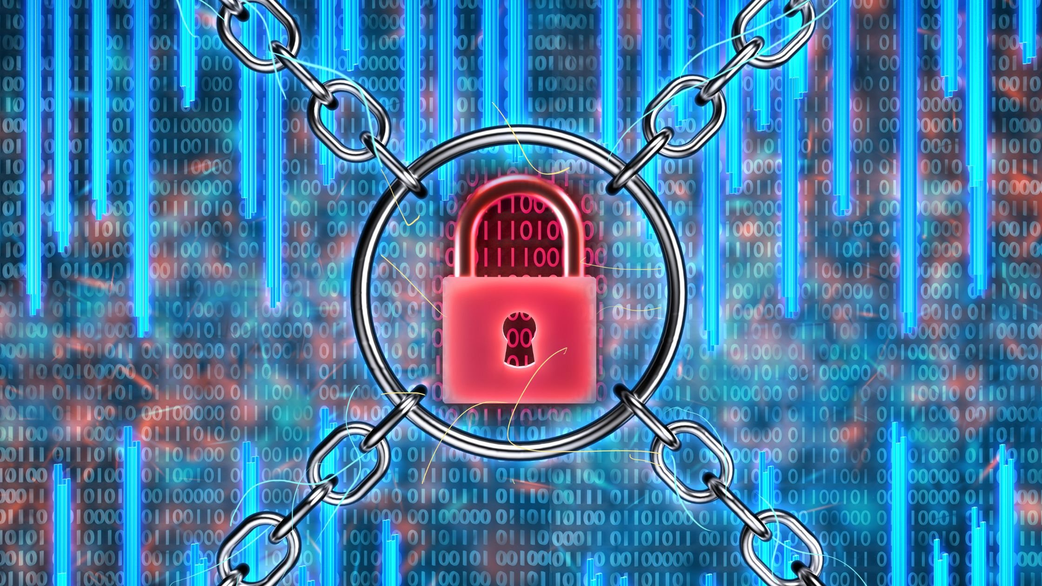
Ransomware
Ransomware attacks on the financial services industry surged by 64% in 2023.
The average cost of a ransomware attack reached $5.13 million in 2023, a 13% increase from the previous year.
In 2023, ransomware attacks impacted 1 in every 10 organizations worldwide, a 33% increase from the previous year.
Recent Ransomware Attacks on Financial Institutions:
Patelco Credit Union (July 2024)
Evolve Bank and Trust (June 2024)
Community Bank Attacks (2021-2022)
Notes:
Patelco Credit Union (July 2024)
A ransomware attack on Patelco Credit Union in California severely disrupted its operations:The attack crippled the credit union's systems for at least four days
Members were unable to access online banking, make electronic payments, deposits, or transfers
Customers had to visit branches or use ATMs to withdraw cash
Account balances and statement information were inaccessible
The timing of the attack at the beginning of the month magnified its impact on customers trying to pay bills1
Evolve Bank and Trust (June 2024)
Evolve Bank and Trust, a U.S. financial institution, fell victim to a major ransomware attack:The Russian-linked ransomware group LockBit claimed responsibility
Attackers allegedly stole 33 terabytes of sensitive banking information
LockBit released a large cache of files containing customer personal information, including Social Security numbers, card data, and wire transfer details
The attack occurred shortly after Evolve Bank received a cease-and-desist order from the Federal Reserve Board citing IT security deficiencies
Community Bank Attacks (2021-2022)
Multiple community banks across the United States experienced ransomware attacks:At least seven community banks in California, Florida, Illinois, Kansas, Michigan, and Minnesota were targeted
In one case, the AvosLocker ransomware group attacked a California community bank in August 2021
Attackers encrypted systems, stole sensitive customer information, and threatened to leak the data
The affected bank had to notify customers and offer credit monitoring services2

Slide 6

Ransomware
Emerging Trends:
Double and triple extortion: Attackers encrypt data and threaten to publish stolen information or contact customers directly.
Targeting smaller institutions: There's an increasing focus on small and medium-sized banks, which may have limited cybersecurity resources.
Operational disruption: Attacks often cause significant operational issues, impacting customer services and potentially threatening the institution's survival.
Evolving tactics: Some attackers are foregoing encryption and relying solely on data theft and extortion threats.
Notes:
Patelco Credit Union (July 2024)
A ransomware attack on Patelco Credit Union in California severely disrupted its operations:The attack crippled the credit union's systems for at least four days
Members were unable to access online banking, make electronic payments, deposits, or transfers
Customers had to visit branches or use ATMs to withdraw cash
Account balances and statement information were inaccessible
The timing of the attack at the beginning of the month magnified its impact on customers trying to pay bills1
Evolve Bank and Trust (June 2024)
Evolve Bank and Trust, a U.S. financial institution, fell victim to a major ransomware attack:The Russian-linked ransomware group LockBit claimed responsibility
Attackers allegedly stole 33 terabytes of sensitive banking information
LockBit released a large cache of files containing customer personal information, including Social Security numbers, card data, and wire transfer details
The attack occurred shortly after Evolve Bank received a cease-and-desist order from the Federal Reserve Board citing IT security deficiencies
Community Bank Attacks (2021-2022)
Multiple community banks across the United States experienced ransomware attacks:At least seven community banks in California, Florida, Illinois, Kansas, Michigan, and Minnesota were targeted
In one case, the AvosLocker ransomware group attacked a California community bank in August 2021
Attackers encrypted systems, stole sensitive customer information, and threatened to leak the data
The affected bank had to notify customers and offer credit monitoring services2

Slide 7

Surviving the Unexpected
Natural Disaster Impact: A hurricane disrupts operations, leading to branch closures, prompting the credit union to deploy mobile branches for member assistance.
Pandemic Response: The COVID-19 pandemic forces the credit union to rapidly enhance online banking and introduce new digital services to adapt to changing member needs.
Power Outage Management: During a sudden power outage at a main branch, staff use backup systems and manual processes while keeping members informed.
Physical Damage Recovery: A fire damages a branch, requiring temporary closure; the credit union quickly assesses the situation and redirects members to other locations.
Cybersecurity Incident: A data breach compromises member information, leading the credit union to promptly notify affected members and strengthen security measures.

Slide 8

Cybersecurity Framework (CSF)
High-profile cyber-attacks underscore the need for strong cybersecurity measures.
Overlooking cybersecurity can lead to financial losses, reputational harm, legal troubles, and operational chaos.
Companies must prioritize cybersecurity through a comprehensive framework that addresses risk management, control implementation, compliance, vulnerability detection, incident response planning, and ongoing improvement efforts.

Slide 9
NIST CSF 2.0
CSF 2.0 Function | CSF 2.0 Category | CSF 2.0 Category Identifier
Govern (GV) | Organizational Context Risk Management Strategy Roles & Responsibilities Policies & Procedures | GV.OC GV.RM GV.RR GV.PO
Identify (ID) | Asset Management Risk Assessment Supply Chain Risk Management Improvement | ID.AM ID.RA ID.SC ID.IM
Protect (PR) | Identify Management, Authentication, and Access Control Awareness & Training Data Security Platform Security Technology Infrastructure Resilience | PR.AA PR.AT PR.DS PR.PS PR.IR
Detect (DE) | Adverse Event Analysis Continuous Monitoring | DE.AE DE.CM
Respond (RS) | Incident Management Incident Analysis Incident Response Reporting & Communication Incident Mitigation | RS.MA RS.AN RS.CO RS.MI
Recover (RC) | Incident Recovery Plan Execution Incident Recovery Communication | RC.RP RC.CO
Notes:
Doug

Slide 10
Consider the Following Scenarios:
Your HR Director tells you that she emailed the W2s you asked her to send​.
You receive an email from a longstanding vendor changing the wire instructions on their account​.
You send a wire in response to an email informing you of changed instructions from a longstanding vendor​.
Ohio Department of Tax calls to inform you that 5 of your employees’ identities were used to file fraudulent tax returns​
On your way to work after a long weekend, you start getting texts that no one can log into the company ERP system ….​
A vendor calls your accounts payable team to ask when payment will be made; AP made the payment via wire a month ago ….​
Customers begin calling your help desk reporting your web application is down; when your development manager logs into to troubleshoot all he finds is a file titled “READ ME” …​
Help desk calls significantly increase with reports of staff having slow running and/or slowly running systems​
A law enforcement officer is at the front desk and wants to speak to the CIO/COO/CEO.

Slide 11
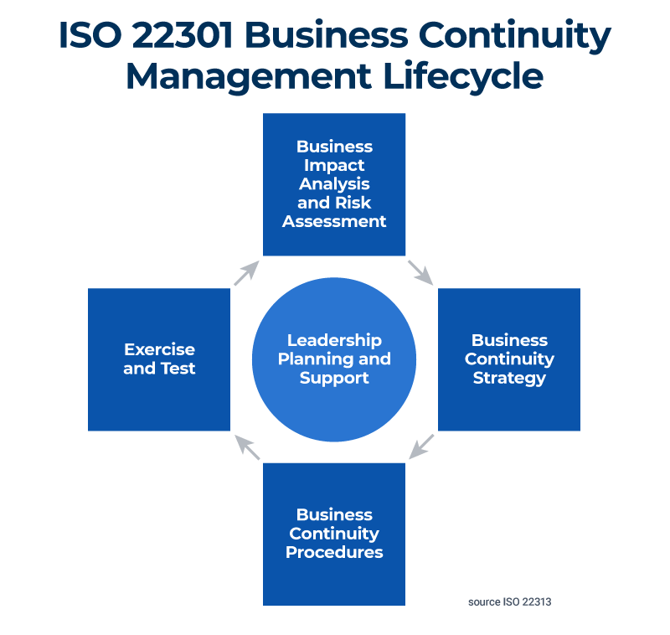
Business Continuity Management System
A holistic program to understand and manager the risks of outages ​
Risk Assessment​
Business Impact Analysis​
Plan Development​
  Business Continuity​
  Technical Recovery​
  Disaster Recovery​
  Crisis Management​
    Incident Response​
Exercise Program​
  Checklist​
  Call list​
  Tabletop or Simulation​

Slide 12
Risk Assessment
Identification of disruptions to the organization​
Analysis and evaluation of the identified risks​
Determination of which risks require treatment
Action | Definition | Example
Risk Acceptance | A risk is accepted with no action taken to mitigate it. | We accept we might fall for an AI Deepfake phone attack given the likelihood is low.
Risk Transference | A risk transferred via a contract to an external party who will assume the risk on an organization’s behalf. | A third-party contract with a key service provider can transfer your risk (but not your obligation to protect) to them. Cyber liability insurance.
Risk Avoidance | A risk is eliminated by not taking any action that would mean the risk could occur. | We might turn down an opportunity to open a CA because regulations there are more difficult creating risks higher than we can accept.
Risk Reduction | Risk reduction is when a risk becomes less severe through actions taken to prevent or minimize its impact. | Following security best practices to identify and implement safeguards to control risk.

Slide 13
Business Impact Analysis (BIA)
A business impact analysis (BIA) tells you what to expect when your business is disrupted, so you can proactively create recovery strategies. ​
Identification of the different parts of the business ​
Identification of the criticality of any part of the business ​
Identification of dependencies on resources ​
(technology, people, vendors, etc.) ​
Identification of the impact ​
  Technology ​
  People ​
  Process & policy ​
  Organization ​
  Business strategy

Slide 14
Plan Development
Business Continuity — Recovery of the operations​​.
Technical Recovery — Recovery of the technology​​.
Disaster Recovery — Large-scale recovery (loss of a building)​.
Incident Response — Response to incidents with escalations to different levels in the business​​.
Crisis Management — The management of a larger-scale incident.

Slide 15
Exercise
Plans must be exercised to identify improvements:​​
Checklist — Finds gaps in plans​​
Call Lists — Makes sure you can communicate ​​
Tabletop — Identifies overall improvements in a plan or the Business Continuity program​​
Simulation — Actual simulation of a loss
*After an exercise make sure you document lessons learned, identify improvements and update plans*

Slide 16
Plan Summary
Plan | Objective | Approach and Scope | Implementation and Maintenance
Business Continuity | Ensure critical business functions continue during a disruption. | Identify critical business processes and develops continuity strategies. | Regular review and testing, including updating as needed.
Technical Recovery | Restore IT systems and infrastructure quickly after a disaster. | Restore IT infrastructure and systems, including data backup and recovery. | Regular backup and testing of recovery processes.
Incident Response | Identify, contain, eradicate and recover from cybersecurity incidents. | Structured approach to incident detection, containment, eradication and recovery. | Regular assessment and testing of the incident response plan.

Slide 17
Backups
  3-2-1 Rule — Keep at least three (3) copies of your data, and store two (2) backup copies on different storage media, with one (1) of them located offsite (Test)​
  RTO — Recovery Time Objective (How long can you be down?)​
  RPO — Recovery Point Objective (How much data can you lose? Determines frequency)

Slide 18
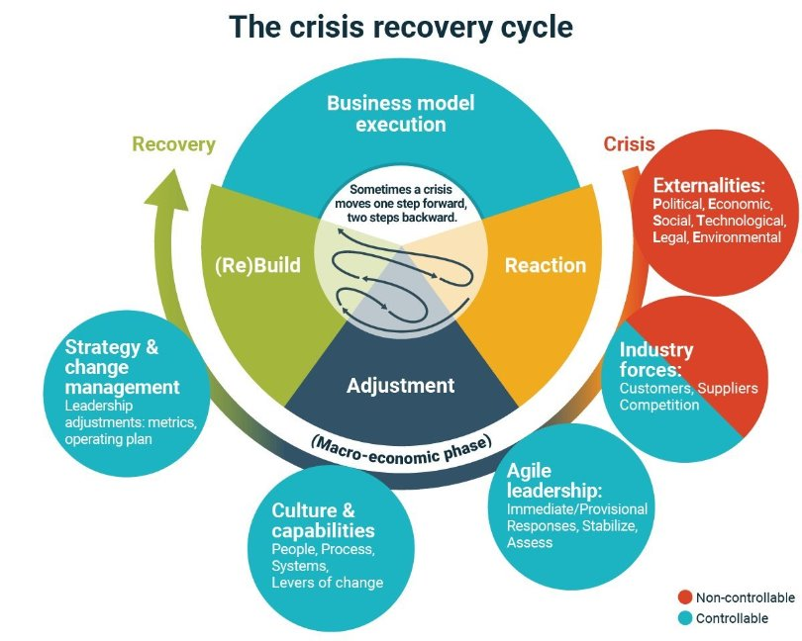
Crisis Management
Detects, responds to and recovers from cybersecurity incidents​.
Minimizes damage, recovery time, and costs from attacks/breaches​.
Identifies, contains, and resolves security incidents​.
Enables swift action against threats, and restores operations​.
Includes phases like preparation, detection, containment, and recovery.​
Follows incident response plan with roles, procedures, and tools.

Slide 19
Cyber Liability Insurance
Review annually with a broker with cyber knowledge and experience​​.
Riders on property & casualty are often not enough​​.
Accurately complete underwriting forms.​​
Understand how much coverage you need.​​
Understand the type of coverage​​.
Business Impact Assessment will help inform the conversation​​.
Increased carrier expectations for documented and tested business continuity, disaster recovery, and incident response plans.

Slide 20
Ransomware Mitigation
Reduce Attack Surface
Strengthen Access Controls
Enhance Security Measures
Improve Backup and Recovery
Employee Training and Awareness
Incident Response Planning
Use Security Assessment Tools
Monitor and Detect
Know your third-party connections
Notes:
Reduce Attack Surface
Maintain an up-to-date inventory of all assets and associated risks
Disable unnecessary ports and services
Implement network segmentation to isolate critical systems
Strengthen Access Controls
Implement robust multi-factor authentication (MFA), especially for privileged accounts
Use the principle of least privilege to limit user access rights
Regularly audit and review user access permissions
Enhance Security Measures
Keep all systems and software patched and up-to-date
Deploy enterprise-level antivirus and anti-malware solutions
Implement email filtering and web filtering to block malicious content
Improve Backup and Recovery
Follow the 3-2-1 backup rule: 3 copies of data, on 2 different media, with 1 copy off-site
Regularly test backup and recovery processes
Store backups offline or on an air-gapped network to prevent encryption by ransomware
Employee Training and Awareness
Conduct regular cybersecurity awareness training for all employees
Teach staff to recognize phishing attempts and other social engineering tactics
Establish clear procedures for reporting suspicious activities
Incident Response Planning
Develop and regularly update a comprehensive incident response plan
Conduct tabletop exercises to test the plan's effectiveness
Establish relationships with law enforcement and cybersecurity firms before an incident occurs
Use Security Assessment Tools
Utilize the Ransomware Self-Assessment Tool (R-SAT) developed by the Bankers Electronic Crimes Taskforce
Regularly perform vulnerability assessments and penetration testing
Monitor and Detect
Implement 24/7 security monitoring and logging
Use security information and event management (SIEM) tools to detect anomalies
Monitor both internal networks and "hyper-local" social media for potential threats or misinformation

Slide 21
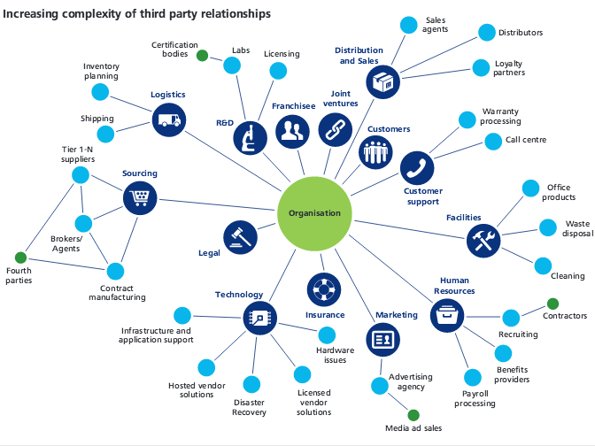
Vendor Risk Management
Vendor risk management (or vendor risk management) programs are also becoming a part of the insurance conversation.
These programs outline a process where critical and high-risk vendors are vetted and, in some cases, monitored to manage the risks inherent in those relationships.
Some carriers focus on cyber supply chain.
Organization

Slide 22
Vendor Risk Management Plan
Vendor inventory and profile
Risk assessment and classification
​Due diligence and vendor engagement
Contract management
Continuous monitoring
Reporting and metrics
Governance and oversight
Policy and standards

Slide 23
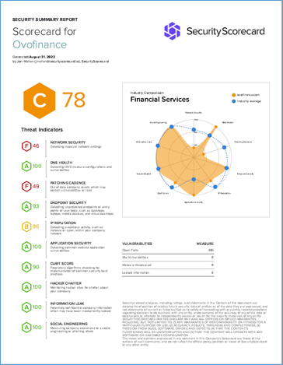
SecurityScorecard
Rates security posture of over 2 million companies using patented tech and data points.
Provides instant risk ratings mapped to vendor questionnaires for cyber risk management.

Slide 24
Questions?

