Slide 1

Implementing RTP®
From Two Credit Unions’ Perspectives
Notes:
Melissa: Welcome everyone, I’m Melissa Ashley President and CEO of Corporate One and I’m grateful you are all here today. As you may be aware, perhaps it’s why you’re here today, immediate payments are heating up here in the U.S. As of July 2023, we have two immediate payment rails in the U.S., TCH’s RTP network and the Federal Reserve’s FedNow Service. As FedNow has come to market, we’ve seen an increased interest in immediate payments and a robust number of financial institutions that have already started participating on the FedNow service. And with two immediate payment rails to choose from it often begs the question of which to start with. Our belief is that you don’t want to wait to get involved in immediate payments. Start now. The two rails are not interoperable, so you must be at least a receive participant on both. So, what does that take? Well, that is what we are here to discuss today.
And to bring a fuller picture to our discussion today is Kathy Haas, President and CEO of Cincinnati Ohio Police Federal Credit Union and Dean Pielemeier, President and CEO of Abbey Credit Union. Kathy and Dean– thanks for braving this session with me and sharing your experiences with implementing immediate payments!
(Kathy and Dean respond and make any opening remarks you like)

Slide 2
Agenda
Industry update
Implementation process
Advice to peers
Q&A
Open discussion on payment challenges at your credit union
©2024 Corporate One Federal Credit Union. All Rights Reserved.
Notes:
We have a simple agenda to cover today, we are going to kick things off by taking a quick looking at what’s happening with immediate payments in the industry, then we will walk through the implementation process for connecting to the RTP network, we will hear some advice from Kathy and Dean. Finally, we will wrap up with your questions.

Slide 3

United States Payments Infrastructure
RTP® Network (TCH)
FedNOW
(The Fed)
Debit/Credit Rail (MC/VISA)
ACH Rail
(NACHA)
Wires
©2024 Corporate One Federal Credit Union. All Rights Reserved.
Notes:
Melissa: So, to kick off our conversation today, in case anyone is new to this conversation, I want to begin with some basic background knowledge.
In today’s payment world transactions travel on separate rails. We have the ACH rail, the Debit/Credit Rail, the wire rail. And now we have The Clearing House’s RTP rail, which has been live since 2017. And in July 2023, The Federal Reserve to launched the FedNow Service and it too is a separate rail.
Now, in order to transact immediate payments on the RTP rail, credit unions will need to connect and be a participant on the RTP network rail. Just as they need to be an ODFI or RDFI on the ACH rail to process payments, they need to be a participant on the RTP rail to receive/send real-time payments. And it is also the case that credit unions need to become a participant on the FedNOW Service in order to conduct transactions on that rail, as the two new immediate payment rails are not be interoperable.
Kathy and Dean- what were some of your first thoughts of RTP and what it was, when you and your team, started learning about it??
Now, let’s take a look at what is happening in the immediate payment space.

Slide 4

Consumers are seeing what’s possible
More than 9 out of 10 Americans used some form of digital payment in 2023.
Nearly 70% of DDAs in the U.S. can receive immediate payments today!
739 financial institutions are on the RTP® network. (231 CUs)
Over 960 financial institutions are already on the FedNow® Service. (194 CUs)
Sources: https://www.mckinsey.com/industries/financial-services/our-insights/banking-matters/consumer-digital-payments-already-mainstream-increasingly-embedded-still-evolving, https://www.theclearinghouse.org/payment-systems/rtp/institution, https://www.frbservices.org/financial-services/fednow/organizations
©2024 Corporate One Federal Credit Union. All Rights Reserved.
Notes:
Meilssa: In 2023, we witnessed significant milestones in immediate payments. The Clearing House’s RTP network experienced its first day with over 1 million transactions, while the Fed introduced the U.S.’ second immediate payment network with the FedNow Service.
Now, why is this important for your organization? This answer is two-fold.
First, it’s no secret that digital payments are becoming more of a standard, especially after the pandemic. In fact, a recent McKinsey survey reported that for the first time more than 9 out of 10 Americans used some form of digital payment in 2023. Thanks to the growing and pretty much commonplace use of digital payments, consumers are seeing what’s possible right now with payments: Payments that are always available, available at the tap of a screen, fast and convenient.
Second, most of the checking and savings accounts in the U.S. are already linked to the RTP network. More than 600 financial institutions are already on the RTP rail and more continue to join each week. Included within those 600+ are all of the major money center banks throughout the US. Given the size and reach of the 600+ financial institutions already on the network, nearly 70% of DDAs have access to the RTP rail. And now, in addition to the RTP network, as of 9/3/24 the FedNow Service already has over 937 FIs participating. This means a majority of consumers now have some access to immediate payments and can at least receive immediate payments. They are seeing what’s possible. For example, folks receiving disbursement payments such as payroll and insurance payouts, to name a few, are receiving these much-needed payments in their accounts sooner. Individuals making transfers between accounts, such as investment accounts, see the money moved immediately instead of over the course of days. But the benefits aren’t just for the receiver—think of the control over cash management the sender has too!
Because of these and many other benefits, now that institutions are connected, they are using it and this is reflective in the consistent growth on the RTP rail since it went live in 2017.
________________________________________
Numbers as of 9/30/24
RTP- 739 (231 credit unions)
FedNow- 960 (194 credit unions)

Slide 5
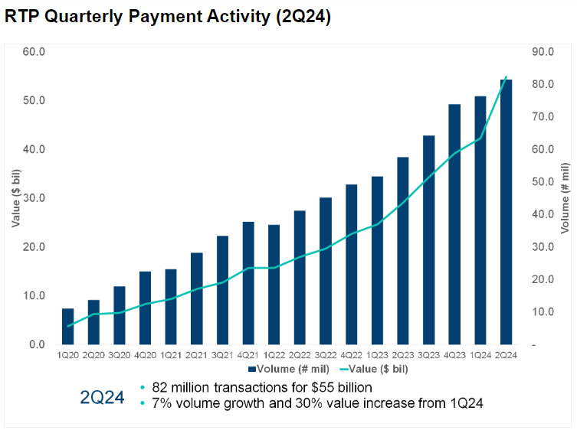
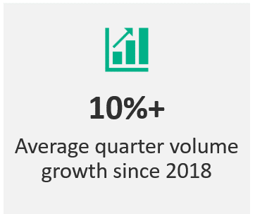
Volume continues to grow
Source: https://www.theclearinghouse.org/payment-systems/rtp
©2024 Corporate One Federal Credit Union. All Rights Reserved.
Notes:
Melissa: TCH has reported that the RTP network has averaged over 10% growth every quarter since 2018. In Q4 of 2023, there were 74 million transactions totaling $39 billion in one quarter. And according to TCH if volume continues to rise at this trajectory, transactions on the RTP network will eclipse Same Day ACH this year. What this means is if your consumers are not already missing out on receiving their money immediately on the RTP rail, they will be soon. And you will be missing out on deposits.

Slide 6
How RTP capabilities are being used today
What are – or will be - the 3 most important use cases for your organization’s RTP strategy?
 | Banks | Credit Unions
B2B payments | 35% | 14%
A2A payments | 23% | 45%
Payroll (or expected payroll) payments | 25% | 22%
Recurring bill pay | 15% | 20%
Last-minute consumer payment | 23% | 31%
Source: Cornerstone Advisors: What’s Going on In Banking 2024
©2024 Corporate One Federal Credit Union. All Rights Reserved.
Notes:
Melissa: So, how are real-time payments currently being used in the industry? Well, the 2024 Cornerstone Advisors “What’s Going on in Banking” survey found that business-to-business payments and payroll were the most-frequently cited use cases by banks. Among credit unions account-to-account transfers, and last-minute consumer payments were the most-frequently mentioned uses cases.
So, this gives us a high-level idea of how immediate payments can and are being used today. But let’s delve deeper into specific real-world applications of immediate payments.
Kathy and Dean- do any of these numbers shock you from your perspective at your credit unions?

Slide 7
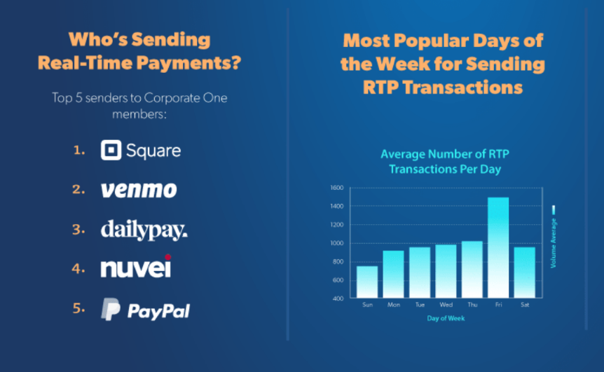
How RTP capabilities are being used today
©2024 Corporate One Federal Credit Union. All Rights Reserved.
Notes:
Melissa: Examining some of our recent data from the credit unions we serve on the networks, we see a variety of senders driving volume and getting people their money in new and immediate ways. The top sender we see is Square. Square provides businesses with point-of-sale technology that it combines with a PayPal-like wallet experience for their clients. After Square we see Venmo. Then we have DailyPay. We all know the dangers of Payday lenders and the vicious cycle of predatory lending that comes with it. In an effort to help consumers avoid the pitfalls of those companies, several companies are providing earned-wage access technology that allows employees to cover the gaps between paydays by accessing the money they have accrued during the pay cycle. DailyPay through PNC, and Payactiv through U.S. Bank are already doing this. For companies that still offer the traditional weekly or biweekly payday, these platforms are providing hourly employees with instant access to their earned wages whenever they need it, regardless of time of day or day of the week.
Kathy and Dean-- what are you seeing at your credit unions anything different than what’s listed here?
Any members coming asking you for it??
And speaking of volume during the week, here are some volume stats from the credit unions we serve on the RTP network. As you can see, Friday sees the most amount of volume. But the rest of the week sees significant volume too- even Saturday and Sunday have payments coming in.

Slide 8
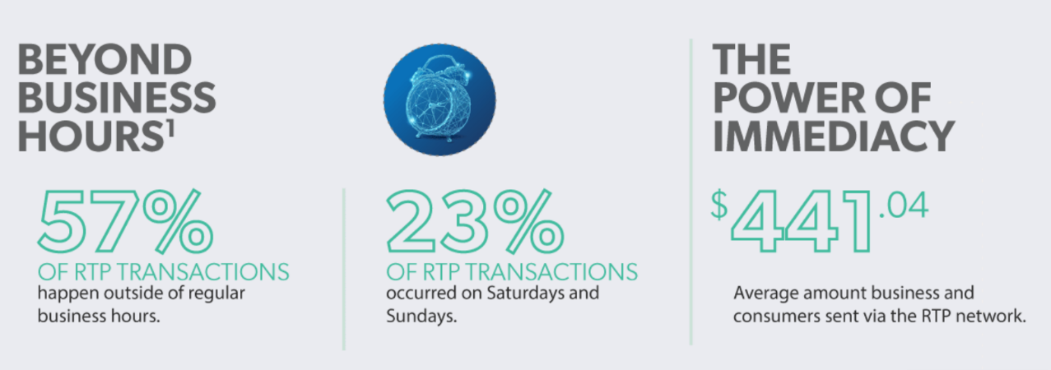
Volume between 5:00 p.m. and 7:00 a.m. ET
1. Statistics based on Eastern Standard Time. All weekend transactions are considered after-hours.
©2024 Corporate One Federal Credit Union. All Rights Reserved.
Notes:
Melissa: And to get a little more granular here are the dollars by time of day. Payments are truly coming in around the clock. As you can see 57% of these payments are coming in after hours which we are identifying as between 5:00 p.m. and 7:00 a.m. ET.
Kathy and Dean….thoughts on time of day, are you seeing the same?

Slide 9
RTP implementation plans
©2024 Corporate One Federal Credit Union. All Rights Reserved.
Source: Cornerstone Advisors: What’s Going on In Banking 2024
Notes:
Melissa: We’ve seen that volume is rising and that immediate payments are being used in a myriad of ways, but what does institution adoption look like? Well, since the launch of The Clearing House’s RTP rail, adoption of RTP has been growing, mainly driven by the large banks. And as this study from Cornerstone illustrates, almost 20% of banks and 15% of credit unions have already adopted RTP. By the end of this year half of the banks and credit unions in the U.S. will be connected to the RTP network. And then you can see about 30% of banks and credit unions have RTP on their road map for next year or later.

Slide 10



©2024 Corporate One Federal Credit Union. All Rights Reserved.
Notes:
Melissa: As you begin to think about adoption you are going to be faced with the question of “With two immediate payment networks to choose from, which do you go with?” Well as I mentioned at the beginning our position is:
Don’t wait to get involved in immediate payments. Start now. The two rails are not interoperable, so understand that you must get on both, especially for receive only. RTP has been up and running for nearly seven years (with growing adoption and volumes already happening), so we encourage FIs to start with that first and then add FedNow as it matures.
Start as receive only. Here’s why:
First, whatever rail credit unions or FIs choose to start with, receive only is the lightest lift and involves the least risk. And it makes sense for credit unions and FIs to at least receive on each rail, so their members and customers have immediate access to their money, regardless of how it is being sent. For the credit unions we have taken live on RTP and those we provide Funding Agent services to we see transactions come in on DAY 1 and grow from there. Once a credit union or FI is receiving, they will begin receiving payments, no doubt about it.
Second, many credit unions jump right into wanting to send instant payments, and our advice is to take it one step at a time. This is important for a couple of reasons. Whether RTP or FedNow, it is a NEW rail. Receive only ensures a credit union can LEARN the rail first at the most introductory level, just receiving payments—the messaging, notifications, new processes that support the operations of a new rail, reconciliation, etc.
It also gives the credit union and FI time to evaluate what send use cases are needed or would be most used by its members and find the right partner(s) and/or develop the experiences to support those use cases. RTP and FedNow are payment rails that facilitate messaging, and neither includes experiences, so that is up to each FI to determine.
Finally, once it comes to send and creating/selecting those experiences, credit unions and FIs will also need to consider which network has the reach their institutions need for their use cases. This is where we see the choice between the two rails coming into play right now. So, while a credit union and FI should receive only on both networks to start, it may then evaluate which one to evolve into receive/send on in the future to reach specific participants it desires and/or to conduct certain types of payments, such as cross border.
But regardless of which rail you choose to implement first, both require very similar decisions on how you implement a connection to the networks.

Slide 11



Enabling immediate payment access
Connects credit unions through a simplified API integration to the RTP® network and FedNow® Service.
Enhance member expectations and competitiveness.
Expand suite of payment solutions with immediate payment capabilities, meet member demands.
©2024 Corporate One Federal Credit Union. All Rights Reserved.
Notes:
Melissa: And our implementation team has been super busy helping credit unions connect to these new rails. Let me give you an overview of what implementation looks like.
Begin by clarifying what our TPSP solutions does/offer (highlight that we are connected to a number of cores to allow for a 45-day onboarding process). Discuss how your team has been busy connecting credit unions to the RTP network and are beginning to onboard credit unions for FedNow.
Our TPSP solutions enables a real-time payments network connection through a simplified API that can be integrated into various products and/or services so credit unions can meet member expectations and remain competitive by adding immediate payments to their suite of solutions.

Slide 12
Connecting to the Future
8 cores and 48 CUs live on RTP
Funding Agent for 81 CUs
3 CUs live on the FedNow Service
©2024 Corporate One Federal Credit Union. All Rights Reserved.
Notes:
Melissa: Currently, we have eight cores live on the RTP network and connected 48 credit unions to RTP and a healthy imple schedule and pipeline for the rest of 2024 and moving into 2025, which includes the FedNow Service. In fact, we already have 3 credit unions up and running on FedNow.
We provide settlement and cash management services as a Funding Agent for RTP to 81 credit unions.
The Fed’s launch of the FedNow Service has increased the spotlight on immediate payments, drawing increased interest from credit unions and attracting significant attention and competition from other corporates, cores and organizations. As a leader in immediate payments, the opportunity is before us to help credit unions realize the benefits of immediate payments and generate new streams of income. With immediate payments being new to the U.S., there is a great opportunity to enhance and develop new solutions related to immediate payments and we are dedicated to continually growing our solution options within the market to add value to our current solution offerings and to meet the evolving needs of credit unions and their members.
---
Cores live on RTP include CUCentric, CUAnswers, CUInterface, Symitar-FiServ, Corelation, Jack Henry, CUSouth, CU Northwest

Slide 13
TPSP implementation steps
CONTRACT SIGNED
INTRODUCTORY CALL
Introduce teams
Set expectations: timeline and credit union involvement.
Review the two dependencies for project to officially begin:
Core readiness
TCH documentation reviewed with credit union
ONCE DEPENDENCIES ARE MET
Weekly status calls are established
KICKOFF CALL HELD
Milestones are achieved
Trainings are held
GO LIVE
©2024 Corporate One Federal Credit Union. All Rights Reserved.
Notes:
Melissa: So, I know many of you are probably thinking that implementing a new payment rail seems like a big endeavor. Well, let me help demystify some of that for, because from our experience we have heard time and again that implementing immediate payments was much easier than anticipated.
Walk through the chart on this slide:
Highlight that Corporate One can turn this around in 45 days usually, but that is reliant on the two dependencies of core readiness and how quickly the credit union completes their TCH or Fed documentation.

Slide 14



COPFCU and Abbey’s experience
TPSP decision criteria
Steps to connecting
Team members involved
Time invested
Project challenges
Advice/lessons learned
©2024 Corporate One Federal Credit Union. All Rights Reserved.
Notes:
Melissa, ask Kathy and Dean to share their perspectives on each of the bullets on this slide.
Transition to the next slide by thanking Kathy and Dean for sharing their experiences and highlighting that their experiences mirror what we are hearing from other credit unions we have brought onto the RTP network. And we have also witnessed the same experiences with the credit unions we have brought onto the FedNow Service.

Slide 15

The FedNow Service implementation process
The process is very similar to RTP.
Additional documentation for the Fed is electronically filled out.
Having RTP prior to FedNow will speed up the project timeline.
©2024 Corporate One Federal Credit Union. All Rights Reserved.
Notes:
Melissa: discuss that implementing the FedNow Service is a very similar process to RTP implementation. There is additional documentation for the Fed that is electronically filled out. But having RTP prior to FedNow will speed up the project timeline.

Slide 16
Q&A
New customer habits, payment methods, and rails offer opportunities in an industry poised for remarkable post-pandemic recovery and growth.
  - Capgemini Research Institute
©2024 Corporate One Federal Credit Union. All Rights Reserved.
Notes:
Melissa: take a few minutes for questions and then transition to CU Corporate RTP, by saying there some thing you would like to get the audience’s feedback on…

Slide 17
CU Corporate RTP
Send and receive corporate RTP business payments on behalf of your credit union (not on behalf of your members).
Easy, convenient way to participate in immediate payments.
©2024 Corporate One Federal Credit Union. All Rights Reserved.
Notes:
Melissa: We developed a new service called CU Corporate RTP. It’s a web-based payment application that allows you to send and receive immediate payments through TCH’s RTP network on behalf of your credit union without having to join the RTP Network yourself. These are not member payments, these are payments to your vendors and business partners. CU Corporate RTP gives your credit union an easy, convenient way to participate in immediate payments, allowing you to learn about, gain confidence with and experience immediate payments for yourself while realizing the benefits immediate payments offer.
We think this has an exciting future, especially as TCH is working on adding correspondent send- Explain what this means.
Describe how credit unions are using the solution today.
As we continue to evolve this solution I’d like to get your input on ways this might benefit you.
Some questions to lead the discussion:
What steps tend to cause delays or complications for handling outgoing payments for institutional needs?
What pain points have you experienced with your current payment system when managing bill payments for your institution?
Are there any manual tasks or workarounds that your team has to rely on to handle payments that affect your overall efficiency?
How does your institution handle exceptions, such as missed or failed payments?
What would an ideal solution look like for managing these exceptions more effectively?
How much do you still rely on legacy payment systems or infrastructure, and how does that impact your operations?
What features or functions are you missing in your current setup that newer technologies could provide?
Where do you see gaps or friction in your current payments ecosystem, when it comes to internal institutional needs?
Have you explored newer payment technologies or solutions? If so, what has been the challenge in implementing them across your processes?
If you could design your ideal payment system from scratch, what would you prioritize in terms of speed, security, or functionality?
What does scalability look like for your current payment operations, and how might more automated solutions benefit you as you grow?
What would be the main benefits for your institution if you could streamline your institutional payment processes, and what obstacles would need to be overcome to achieve that?

Slide 18






Contact Us
Barb kren
VP, Member Success Executive
bkren@corporateone.coop
Donna Williams
AVP, Member Success Consultant
dwilliams@corporateone.coop
Jennifer Leu
AVP, Member Success Executive
jleu@corporateone.coop
Landon Gaines
VP, Key Account Strategist
lgaines@corporateone.coop
Nick Behler
AVP, Member Success Executive
nbehler@corporateone.coop
Merrijo Hale
AVP, Member Growth Executive
mhale@corporateone.coop
Notes:
We at Corporate One certainly learned a lot in our immediate payment journey, so please know we are excited to share our knowledge with you and you can lean on us as your partners.
If you have additional questions that didn’t get answered today, or would like to learn more, you can reach out to your Corporate One member success representative with the information on your screen.
You can also find more information on immediate payments within our Real-time Payments Info Center on our website. We have a comprehensive array of resources in there that cover everything from the basics to the more complicated aspects of immediate payments, such as understanding the messaging.
And, thank you all for joining us for this presentation, I hope you found some useful information. Have a great rest of your day!

Slide 19
Immediate Payments: A continuous evolution
Request for Payment (RfP)
©2024 Corporate One Federal Credit Union. All Rights Reserved.

Slide 20
What is Request for Pay (RfP)
Profile on both RTP and FedNow Service that enables a payee to send a bill (aka, request a payment) to the payor digitally through secure FI channels that can trigger an immediate payment in return
Provides context for the payment which enables straight through processing of the result payment
Messages are designed to complement and augment electronic billing and invoicing processes
Alternative to ACH direct debits
©2024 Corporate One Federal Credit Union. All Rights Reserved.
Notes:
Collaborate Session on RfP
As an organization we want to stay on the bleeding edge of immediate payments and that means continuing to understand what’s coming down the line and talking about the impact it may have on the CU industry and our membership as a whole. Melissa reelected to business committee so we can keep our eyes on what the big guys are doing.
Want to spend some time talking about what the next iteration is going to be in RTP and it will be RfP.
RfP – Is a non-financial message that is sent through the RTP network and presented to the RfP Received(Customer) through the RfP Receiving Participant’s secure bank channels. Customer can respond by making a RTP to move the money from their bank account

Slide 21






RfP process flow
FedNow Service
and RTP
RfP Requestor
(Creditor)
Requestor’s
Financial
Institution/
Account
(Creditor Agent)
Payor’s
Financial
Institution/
Account
(Debtor Agent)
RfP Payor
(Debtor)
©2024 Corporate One Federal Credit Union. All Rights Reserved.
Notes:
HG to update notes, if we keep.
Step 1: The Sender (Creditor in ISO messages) initiates a request for payment with their FI through an end-user interface outside of the FedNow Service.
Step 2: The Sender FI (Creditor Agent) sends a request for payment message (pain.013) to the Receiver FI (Debtor Agent) across the FedNow Service.
Step 3 Optional (unless rejected by FI) but recommended best practice: The Receiver FI determines how it will handle the message and provides an initial RFP response (pain.014) to the Sender FI. If the Receiver FI decides to reject the RFP, then it must send a negative request for payment response to so inform the FedNow participant that sent the request for payment. The initial response could also inform that the RFP was Received (RCVD) or that the RFP has been Presented (PRES) to the Receiver FI’s end customer (Debtor).
Step 4: The Receiver FI presents the RFP to the RFP Receiver (Debtor) through an end-user interface outside of the FedNow Service.
Step 5: The RFP Receiver accepts or rejects the request for payment. If accepts, push credit. Good funds. No day 2 adjustments…
Step 6: The Receiver FI sends a final RFP response (pain.014) to the Sender FI through the FedNow Service.
Step 7: The Sender FI notifies the RFP Sender that the RFP was Accepted or Rejected though an end-user interface outside of the FedNow Service

Slide 22
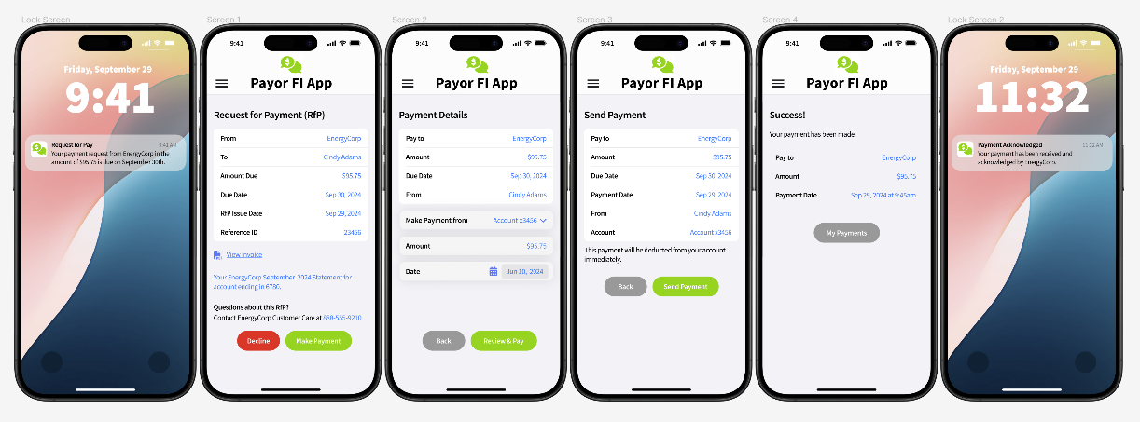
RfP example
©2024 Corporate One Federal Credit Union. All Rights Reserved.
Notes:
So, to bring this into the real world, here’s an example of how an RfP would work.
Within the CU digital banking app…

Slide 23
RfP benefits
Immediate settlement
Data rich messaging
  Payment confirmation
  Payment and customer details in single conversation
More efficient processing as a result of immediacy and messaging details
Around-the-clock availability
Reduced fraud compared to item processing and other electronic payments
Lower costs
Versatile
Enhanced and improved experiences/doing business
©2024 Corporate One Federal Credit Union. All Rights Reserved.

Slide 24



















RfP use cases
Merchant payouts
Loan disbursements
Merchant/POS/e-commerce
Wallet funding/defunding
RfP
Business to business
One-time bills
Small business
Person to person
Me to me
©2024 Corporate One Federal Credit Union. All Rights Reserved.
Notes:
Let’s take a look at some of the use cases could utilize RfP functionality:
Can ask board what use cases they see working for them the most, any others not mentioned?
1. Consumer Bill Pay: Utilities, telecom companies, and other service providers can use RfP to request payments from consumers for recurring bills. This streamlines the payment process and ensures timely payments¹.
2. Business-to-Business (B2B) Payments: Businesses can use RfP to request payments from other businesses for invoices, supplies, or services. This can help improve cash flow and reduce the time spent on payment collections¹.
3. Account-to-Account Transfers: Individuals can use RfP to request transfers between their own accounts at different financial institutions, making it easier to manage funds across multiple accounts.
4. Loan Disbursements: Financial institutions can use RfP to disburse loan amounts to borrowers instantly, providing quicker access to funds.
5. Merchant Payouts: Merchants can use RfP to request payments from customers for goods and services, facilitating faster and more secure transactions.
6. Real Estate Transactions: RfP can be used to request payments for real estate transactions, such as down payments or closing costs, ensuring immediate and secure transfer of funds.
These use cases highlight the versatility and efficiency of RfP in various financial transactions.

Slide 25
How RfP is being used today on RTP
By the Numbers
Permissible Use Cases
70K RfPs sent since July 2023
12 FIs registered 71 RfP senders (experiences)
Established warranty framework (for FIs certifying businesses to send RfPs)
B2B
A2A (Me2Me Bank & Broker)
Bill pay
Consumer down payment, security deposit, final payment
Brokerage A2A leading use case, bill pay is second
©2024 Corporate One Federal Credit Union. All Rights Reserved.
Notes:
Info pulled from TCH RTP Bank Planning meeting presentation from KC/TT in April 2024.
Note: TCH has only enabled permissible use cases at the moment. They have a phased approach to adding new use cases to ensure standardization of experience, security and

Slide 26
How RfP is being used today on FedNow
By the Numbers
Use Cases
240 FIs certified for RfP
No more than six currently as senders on the service are still low/growing
  Only closed-network functionality permitted (where both parties have full RfP send messages/receive messages and then send back payment)
Leading use cases relate to loan funding (via closed networks) for:
  Regional FIs and auto dealers and mortgage companies
©2024 Corporate One Federal Credit Union. All Rights Reserved.
Notes:
There are about 240 FIs of 943 on FedNow certified for RfP, however only 5-6 are actually using it since both the sending and receiving institutions must have the ability to send payments.
Info a/o 8/23/24, per the Fed (Diana)

Slide 27
RfP looking ahead
A Key priority for TCH with defined roadmap
  Risk-based approach to market adoption
    Goal to support consumer RfP receive/responding send by end of 2025
The Fed
  Focus is on growing senders on the service that will in turn support those certified for RfP to be fully functional
Corporate One
  Focus on learning and developing capabilities
  Enable all CUs to receive RfP and then respond with a payment
  Offer CUs capability to send RfPs to request and then receive payments
  Stay on cutting-edge to support CUs that want to be early adopters and provide thought leadership
©2024 Corporate One Federal Credit Union. All Rights Reserved.
Notes:
While there is certainly more room to grow immediate payments adoption, volumes and usage, there is no doubt that RfP presents some exciting new opportunities that will contribute to the momentum we are already seeing. As a result, RfP is a significant priority for TCH as it develops the RTP network. They have a comprehensive, planful and risk-based approach to market adoption that includes specific goal and KPI tracking (each quarter), and has targeted consumer RfP as a permissible use case by end of 2025. Further, it is pushing all member banks to implement RfP within the next year.
As we look ahead…
Info pulled from TCH RTP Bank Planning meeting presentation from KC/TT in April 2024.

Slide 28

Use case: Receiving and responding to RfPs
FedNow Service
and RTP
Netflix
(Creditor)
Netflix’s
Financial
Institution
(Creditor Agent)
Your Credit Union
(Debtor Agent)
Your Member
(Debtor)
©2024 Corporate One Federal Credit Union. All Rights Reserved.
Notes:
HG to update notes, if we keep.
Step 1: The Sender (Creditor in ISO messages) initiates a request for payment with their FI through an end-user interface outside of the FedNow Service.
Step 2: The Sender FI (Creditor Agent) sends a request for payment message (pain.013) to the Receiver FI (Debtor Agent) across the FedNow Service.
Step 3 Optional (unless rejected by FI) but recommended best practice: The Receiver FI determines how it will handle the message and provides an initial RFP response (pain.014) to the Sender FI. If the Receiver FI decides to reject the RFP, then it must send a negative request for payment response to so inform the FedNow participant that sent the request for payment. The initial response could also inform that the RFP was Received (RCVD) or that the RFP has been Presented (PRES) to the Receiver FI’s end customer (Debtor).
Step 4: The Receiver FI presents the RFP to the RFP Receiver (Debtor) through an end-user interface outside of the FedNow Service.
Step 5: The RFP Receiver accepts or rejects the request for payment.
Step 6: The Receiver FI sends a final RFP response (pain.014) to the Sender FI through the FedNow Service.
Step 7: The Sender FI notifies the RFP Sender that the RFP was Accepted or Rejected though an end-user interface outside of the FedNow Service

Slide 29

Use case: Sending RfPs for loan payments
FedNow Service
and RTP
Your Credit Union
(Creditor)
Corporate One
(Creditor Agent)
Borrower’s Primary FI
(Debtor Agent)
Borrower
(Debtor)
©2024 Corporate One Federal Credit Union. All Rights Reserved.
Notes:
HG to update notes, if we keep.
Step 1: The Sender (Creditor in ISO messages) initiates a request for payment with their FI through an end-user interface outside of the FedNow Service.
Step 2: The Sender FI (Creditor Agent) sends a request for payment message (pain.013) to the Receiver FI (Debtor Agent) across the FedNow Service.
Step 3 Optional (unless rejected by FI) but recommended best practice: The Receiver FI determines how it will handle the message and provides an initial RFP response (pain.014) to the Sender FI. If the Receiver FI decides to reject the RFP, then it must send a negative request for payment response to so inform the FedNow participant that sent the request for payment. The initial response could also inform that the RFP was Received (RCVD) or that the RFP has been Presented (PRES) to the Receiver FI’s end customer (Debtor).
Step 4: The Receiver FI presents the RFP to the RFP Receiver (Debtor) through an end-user interface outside of the FedNow Service.
Step 5: The RFP Receiver accepts or rejects the request for payment.
Step 6: The Receiver FI sends a final RFP response (pain.014) to the Sender FI through the FedNow Service.
Step 7: The Sender FI notifies the RFP Sender that the RFP was Accepted or Rejected though an end-user interface outside of the FedNow Service

Slide 30
Use case: Warranty businesses for RfP
FedNow Service
and RTP
Your Business Member
(Creditor)
Your Credit Union
(Creditor Agent)
Customer’s
Financial
Institution
(Debtor Agent)
Customer
(Debtor)
©2024 Corporate One Federal Credit Union. All Rights Reserved.
Notes:
HG to update notes, if we keep.
Step 1: The Sender (Creditor in ISO messages) initiates a request for payment with their FI through an end-user interface outside of the FedNow Service.
Step 2: The Sender FI (Creditor Agent) sends a request for payment message (pain.013) to the Receiver FI (Debtor Agent) across the FedNow Service.
Step 3 Optional (unless rejected by FI) but recommended best practice: The Receiver FI determines how it will handle the message and provides an initial RFP response (pain.014) to the Sender FI. If the Receiver FI decides to reject the RFP, then it must send a negative request for payment response to so inform the FedNow participant that sent the request for payment. The initial response could also inform that the RFP was Received (RCVD) or that the RFP has been Presented (PRES) to the Receiver FI’s end customer (Debtor).
Step 4: The Receiver FI presents the RFP to the RFP Receiver (Debtor) through an end-user interface outside of the FedNow Service.
Step 5: The RFP Receiver accepts or rejects the request for payment.
Step 6: The Receiver FI sends a final RFP response (pain.014) to the Sender FI through the FedNow Service.
Step 7: The Sender FI notifies the RFP Sender that the RFP was Accepted or Rejected though an end-user interface outside of the FedNow Service

